Slide 1
Employee Data Analysis using Excel
STUDENT NAME:NANDHINI.C.S
REGISTER NO:312200281
DEPARTMENT: BCOM Accounting and finance
COLLEGE:S.I.V.E.T college

Slide 2
PROJECT TITLE
Employee Performance Analysis using Excel

Slide 3


AGENDA
Problem Statement
Project Overview
End Users
Our Solution and Proposition
Dataset Description
Modelling Approach
Results and Discussion
Conclusion
3/21/2024 Annual Review

Slide 4

PROBLEM STATEMENT
"Given a dataset containing employee information, including salary, the objective is to analyze the data to identify trends, disparities, and key factors influencing employee compensation. The goal is to provide actionable insights that can help in optimizing salary structures, ensuring fair compensation practices, and supporting strategic decision-making in HR management."

Slide 5

PROJECT OVERVIEW
.
The objective of this project is to organize, analyze, and
visualize employee data, including salary details, to support
decision-making processes regarding compensation,
workforce planning, and performance management

Slide 6

WHO ARE THE END USERS?
Human Resource (HR) Department
Finance Department Top
Management and Executives
Department Management and
Supervisors Auditors (Internal & External)
Employees (Limited Access)

Slide 7

OUR SOLUTION AND ITS VALUE PROPOSITION
OUR SOLUTION :
Our solution provides a comprehensive Excel-based tool for managing and analyzing employee salary data. It is designed to streamline payroll processes, ensure data accuracy, and enhance strategic decision-making.
VALUE PROPOSITION :
Efficiency and time savings Cost
effective solution Data driven
decision making Enhanced
transparency and compliance
Improved employee satisfaction

Slide 8
Dataset Description
When describing employee salary data in an Excel sheet, it’s important to provide clear labels and consistent formatting to make the data easy to understand and analyze. Here’s a typical structure and description of what each column might represent:
Work Year
Experince Level
Employee Type
Job Title
Salary -usd
Salary
Salary currency
Employee Residence
remote ratio
Company location
Company size

Slide 9

THE "WOW" IN OUR SOLUTION
It helps the management to analyze the data's of the employee and their salaries, for the record and understanding the information that have been recorded and it can be used for future purposes
3/21/2024 Annual Review
9

Slide 10
MODELLING
Pie chart
To show the proposition of total compensation across the different departments and data
Data manipulation
Data manipulation involved cleaning, transforming, filtering and aggregating data for analysis
Data manipulation
1. Go to insert <pivot table
2. Choose the date range where you want to insert
3.drage the field into columns rows and values areas
To analyze data
10
Data manipulation involves cleaning, transforming,
he proportion of total compensation across
Different departments and role
Using Excel tools for analyzing employee salary data
Data manipulation involves cleaning, transforming,
Pie chart
To show
Pie chart
To show
Data manipulation involves cleaning, transforming,
It helps the management to analyze the data's of the employee and their salaries, for the record and understanding the information that have been recorded and it can be used for future purposes
To show the proportion of total compensation across
To show the proportion of total compensation across

Slide 11
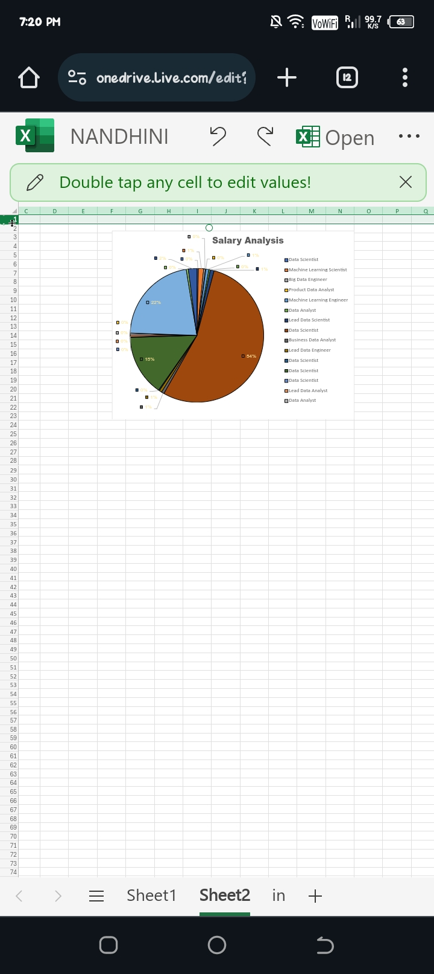
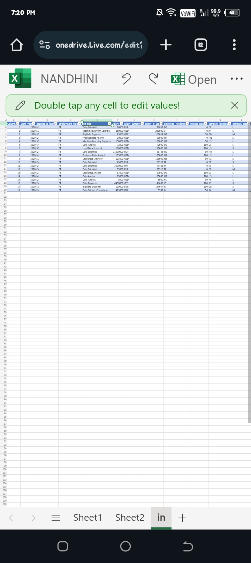
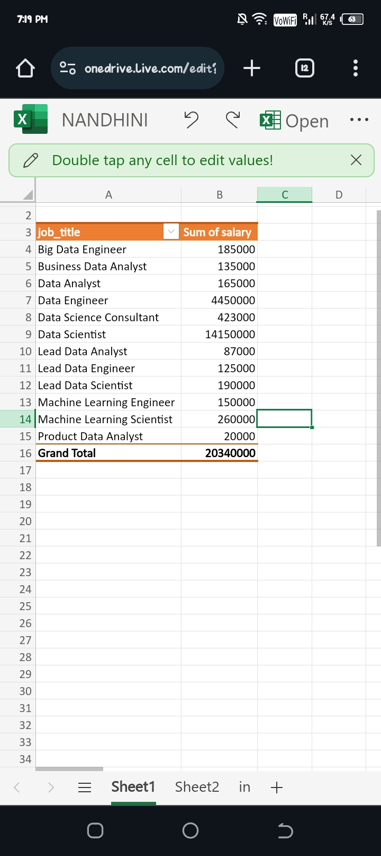
RESULTS
11

Slide 12
conclusion
Using Excel tools for analyzing employee salary data
provides a clear overview. Features such as PivotTables, charts, and data manipulation help in summarizing, visualizing, and identifying trends or outliers effectively, leading to informed decision- making.
provides a clear overview. Features such as PivotTables, charts, and data manipulation help in summarizing, visualizing, and identifying trends or outliers effectively, leading to informed decision- making.

